Slide 1
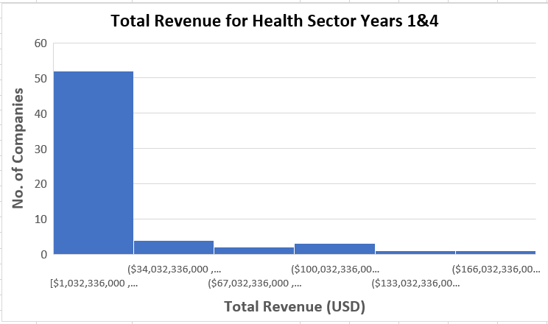
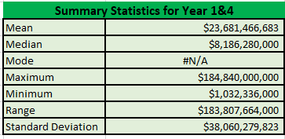
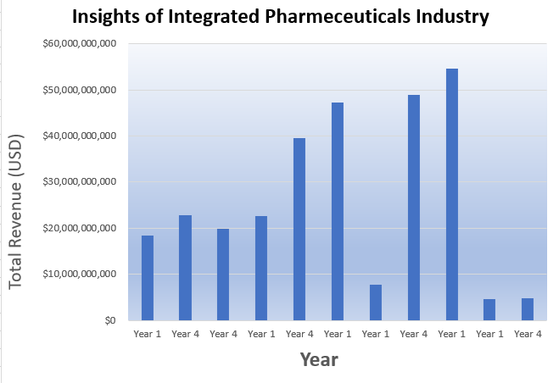
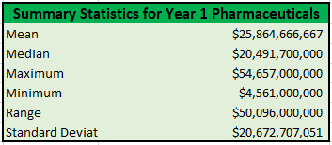
Total Revenue for Health Care Sector in Year 1&4
The histogram on the left is indicative of the Health Care Sector for the 1st and 4th year. The histogram is right skewed indicating that the median is less than the total revenue. The combined maximum for year 1 and 4 is $184.840B and the combined minimum is $1.032B. The standard deviation of $38.06B suggests the healthcare companies experienced wide fluctuations over the two-year period.
Focusing on the Integrated Pharmaceutical Industry, the chart on bottom left shows Year 1 generated higher revenues than Year 4.
The Total Revenue in Year 1 was $155.18B and Year 4 was $136.05B.

